Slide 1
Demographic Scenario(2021-2041) and How to get dividend through TVET (M-01.01)
By
Dr. Sheikh Abu Reza
Former Director (P&D), DTE &
CBT&A Trainer

Slide 2
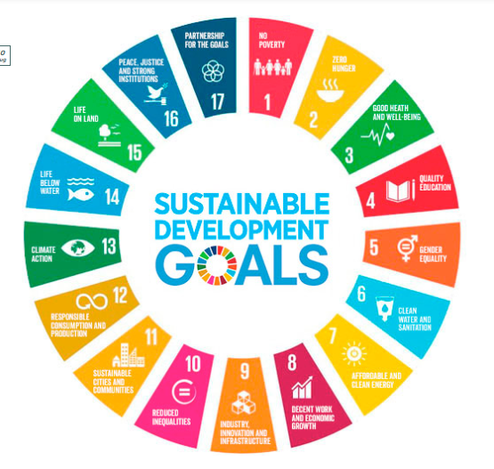

Slide 3
4 important SDG-related focus areas of TEVT
Quality Education (SDG 4): TVET ensures inclusive and equitable quality education and promotes lifelong learning opportunities, especially through skill-based training.
Decent Work and Economic Growth (SDG 8): TVET helps create a skilled workforce, supporting employment, entrepreneurship, and economic productivity.
Industry, Innovation, and Infrastructure (SDG 9): Skilled human resources from TVET contribute to industrial development, technological advancement, and infrastructure growth.
Reduced Inequalities (SDG 10): TVET provides marginalized groups, including youth and women, with equal opportunities for skills development and employment.

Slide 4
SDGs by 2030-2041
Bangladesh has experienced significant economic growth now.
The country is currently at an important stage of development.
The government aims to achieve the Sustainable Development Goals (SDGs) by 2030.
The goal is to become a middle-income country by 2030.
Bangladesh is working towards becoming a developed country by 2041

Slide 5
New Development Agenda
Agenda 2030 is a global development plan to guide the world.
Its success depends largely on demographic changes over the next 15 years and beyond.
These changes will bring both opportunities and challenges.
A major challenge will be adapting to a global population of 8.4 billion by 2030.
It is important to ensure fair, inclusive, and sustainable economic growth for everyone

Slide 6
Demographic Window of Opportunity
The global number of young people is higher than ever before.
As mortality and fertility rates go down, more people are of working age compared to dependents (children and elderly).
This creates a one-time “demographic window of opportunity” for economic growth.
However, this window won’t last—dependency will rise again as the elderly population grows.
This opportunity does not automatically result in a “demographic dividend”; it requires proper planning and investment.

Slide 7
Country Invests
To gain a demographic dividend, the country must invest in:
Health
Education
Skill development
Job creation for adolescents and youth
Promoting gender equality and empowering women is also essential, especially in Bangladesh

Slide 8
Visionary Action Plan
The financial sector must adopt a clear and forward-looking action plan.
It requires not only good education but also awareness and dedication.
Big ideas, smart plans, and focused investments are essential for economic growth.
Investing in priority sectors can boost the economy quickly.
The hard work and talent of our people can drive progress faster.
We have a great advantage through our demographic dividend (a large young and working-age population).

Slide 9
Demographic Dividend
The demographic dividend can be used effectively if three key conditions are met:
Better health, especially for women and children
Leads to lower child mortality and fewer births per family
Increases the working-age population
Investment in education and health
Equips young people with the skills and well-being needed for work
Job creation and economic opportunities
Provides employment for the growing workforce
Ensures their potential is used to boost the economy

Slide 10
4 benefits to a demographic dividend:
A demographic dividend happens when the number of working people is higher than the number of non-working people.
Economists say this brings four main benefits:
More labour supply – More people are available to work.
Higher savings – Working people tend to save more, boosting national savings.
Better human capital – With proper investment, the workforce becomes more skilled and productive.
Expansion of the domestic market – More workers mean more income and more spending, which grows the economy.

Slide 11
By 2040 - Bangladesh's economic growth
These four benefits can only be achieved if we properly utilize our youth workforce.
The demographic dividend period lasts for about 20 to 30 years in a country.
For Bangladesh, this window of opportunity will start to decline after 2040.
Currently, about 65% of the population in Bangladesh is of working age.
The total number of working-age people is 106.1 million (10 crore 61 lakh).
Out of this:
The actual labour force is 62.1 million.
59.5 million are employed in the public and private sectors.
2.6 million are actively seeking jobs (fully unemployed).
44 million are not part of the labour force at all (completely unemployed or inactive).

Slide 12
Time to boost the country's economy
Now is the right time to grow the economy by involving the working population in productive social and economic activities.
Countries like China, South Korea, Vietnam, Taiwan, and Thailand have improved their economies by making good use of the demographic dividend.
If Bangladesh can also use this opportunity:
Per capita income will increase.
More people will become economically active.
National savings will grow.

Slide 13
Appropriate use of Demographic Dividend.
The garment sector is still the main source of Bangladesh's export earnings, making up 86% of total exports.
There is now an urgent need for investment in other key sectors, such as:
Information and Communication Technology (ICT)
Light Engineering
Tourism and Hospitality
Agriculture
Service industries
If the youth workforce is given long-term, planned training in these areas:
They can build strong careers both nationally and internationally.
As a result, Bangladesh can become a middle-income country soon, and be well on its way to becoming a developed country by 2041.

Slide 14

Best Wishes to All

Slide 15
Dr. Sheikh Abu Reza
Mob: 01711802800
Email: bteb.reza@gmail.com
Github: github.com/reza-iist
Youtube: youtube.com/@abureza

